Slide 1

The concept of information system-based decision making
We uhhhhhhhhhhh yes wdk

Slide 2
Basic Framework for Information Systems Based Decision Making

Slide 3
Understanding Decision Making
In general, decision making is an attempt to solve a problem by selecting existing alternative solutions.

Slide 4
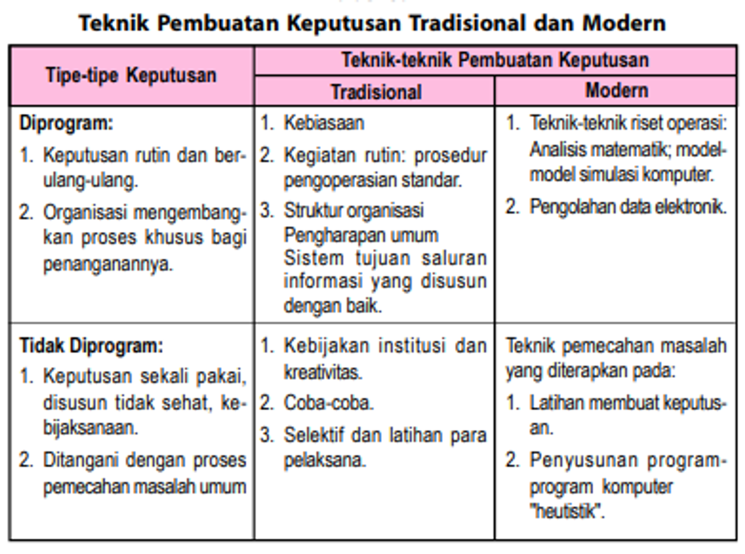
Decision Making Techniques

Slide 5
Decision Making Techniques
Understanding
Planning
Election

Slide 6
Decision Making Measurement Scale
The essence of decision making is a problem solving process. Quantitative benchmarks are used to facilitate comparisons. The scale of this benchmark is composed of existing limitations

Slide 7
Decision Making Measurement Scale
Nominal Scale
Ordinal Scale
Interval Scale
Ratio Scale
Absolute Scale

Slide 8
Konsep Dasar Pengambilan Keputusan Manajemen

Slide 9
Basis and Factors for Decision Making
Intuition
Experience
Authority
Fact
Rational

Slide 10
Decision-making factors
Internal state of the organization
Availability of required information
External circumstances of the organization
Personality and decision-making skills

Slide 11

Quantitative Methods in decision making

Slide 12
Operations research concept
is a quantitative approach to decision making that uses scientific methods, mathematical models, and computers
7 main charactheristics
Focused on decision making
Use of scientific methods
Use of mathematical models
Economic effectiveness
Computer dependent
Team approach
System organization

Slide 13
Operations research model
The operations research model is a simplification of reality used to understand and solve problems
Operation Research Model:
Linear programming
Queuing theory
Network analysis
Game theory
Markov chain model
Dynamic programs
Simulation

Slide 14
Operations research applications
Inventory problems
Allocation problems
Queuing problems
Sequencing issues
Routing problems
Replacement issues
Competition issues
Search problems

Slide 15
Decision making process
The decision making process is a series of activities to select the best alternative to solve a problem. There are various decision-making process models that can be used, depending on the complexity of the problem at hand.

Slide 16
Management Decision Type
Programmed Decision
Half/Partially Programmed Decision
Unprogrammed / Unstructured Decision

Slide 17
Mechanism, Stage, and Model of Decision Making in an Organization

Slide 18
Decision Making Mechanism in an Organization
Decision making mechanism is a set of activities that is done in order to solve a problem
Understanding and Problem Formulation
Collection and analysis of relevant data
Choosing the best alternative
Decision Implementation
Evaluation

Slide 19
Decision Making Stage
There are 7 stages while making decision

Slide 20
Other types of Decision Making Models
Mintzberg Decision Making Model
Rational Decision Making Model
Classic Decision Making Model
Behavioral Decision Making Model
Carnegie Decision Making Model
Benefit Based Decision Making Model
Problem Based Decision Making Model
Field Based Decision Making Model
Problem Tree Decision Making Model

Slide 21
thx

